Slide 1

Human Activity Recognition using Smartphones​
An Applied Machine Learning Project
By Krushal Shah, Ram Kishore, Sai Pokuri

Slide 2
Introduction
4
Preprocessing::
Noise filtering​
Sliding windows of 2.56 seconds with 50% overlap (128 readings/window)​
Butterworth low-pass filter (0.3 Hz cutoff) to separate body acceleration and gravity​
1
Participants:
30 individuals, aged 19-48
Activities::
WALKING​
WALKING_UPSTAIRS​
WALKING_DOWNSTAIRS​
SITTING​
STANDING​
LAYING​
2
Features::
Triaxial acceleration from accelerometer​
Estimated body acceleration​
Triaxial angular velocity from gyroscope​
561-feature vector (time and frequency domain variables)​
Subject identifier
5
1
1
3
Device Used::
Smartphone (Samsung Galaxy S II) worn on the waist​
Captured 3-axis linear acceleration and 3-axis angular velocity at 50Hz​
6
1
Dataset Partitioning::
70% of volunteers for training data​
30% of volunteers for test data​

Slide 3


Exploratory Data Analysis (EDA)​
Data Overview:
Provides a snapshot of the dataset's size and structure, helping to understand the scope and nature of the data.
Data Distribution:
Ensures that the data set is balanced across different activities and subjects, which is crucial for unbiased model training.
T-SNE Visualization:
It offers insights into the clustering and separability of data points in a lower-dimensional space, adding to visual data exploration.
Correlation Matrix:
It helps identify redundant features and understand relationships between different sensor readings, which can guide feature selection.
Feature Importances:
Identifies key features that significantly impact the classification task, enabling more focused and efficient model training

Slide 4
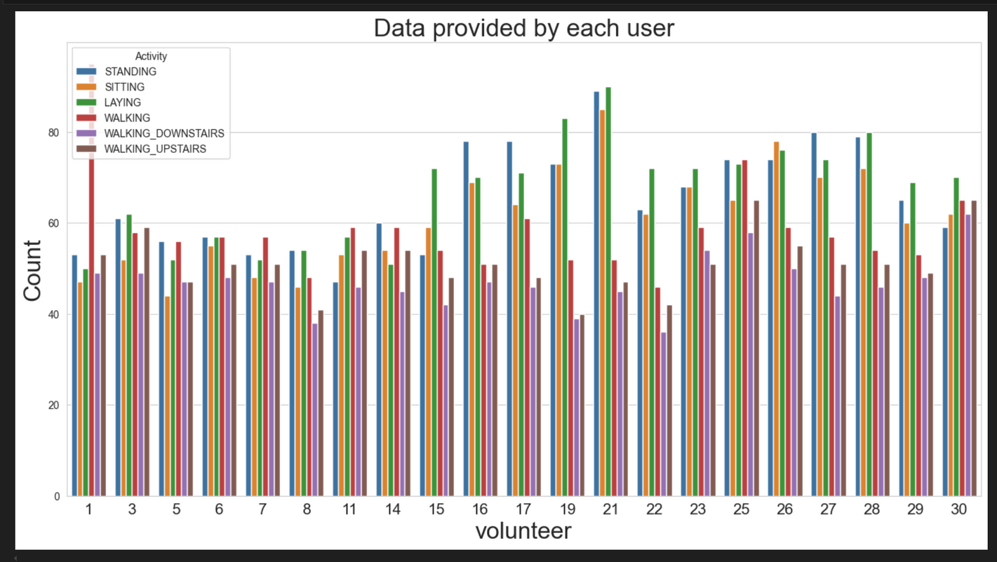
Data Visualization

Slide 5
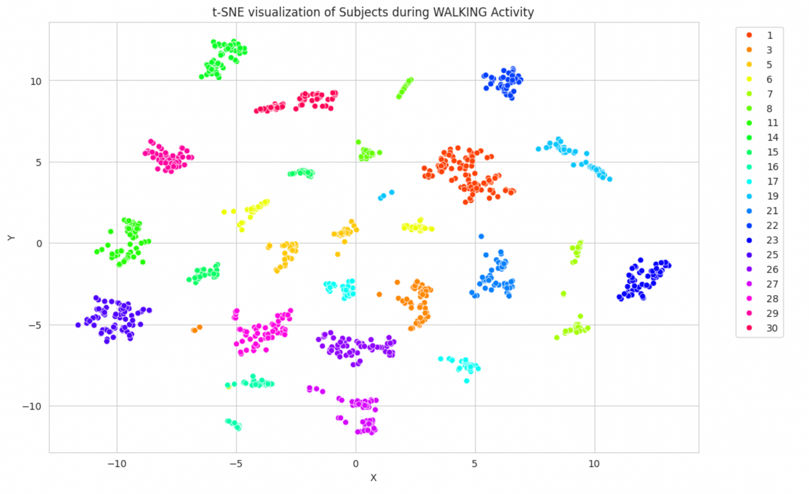
Walking Activity

Slide 6
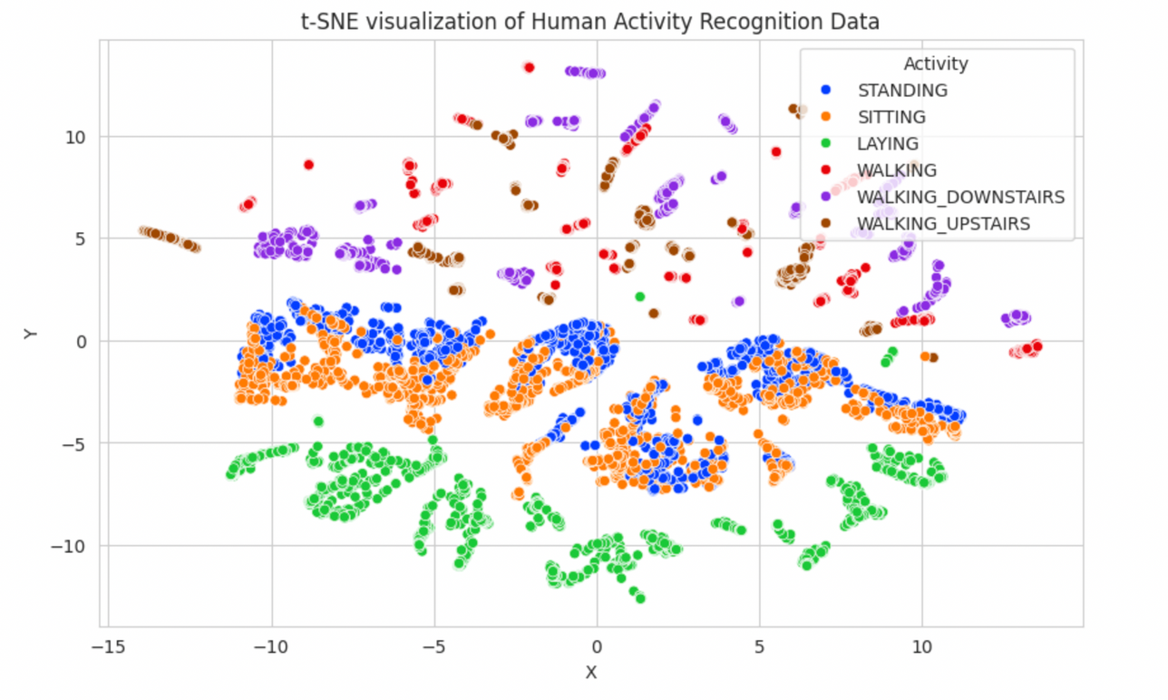
All Activity Recognition

Slide 7
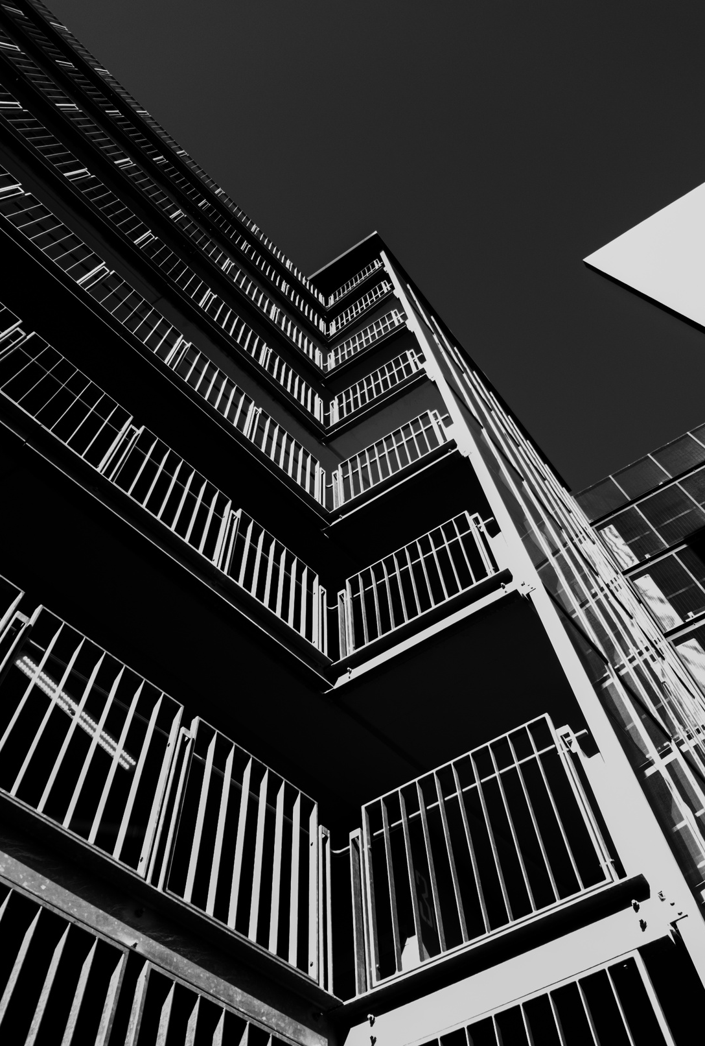
Model Evaluation
The HAR dataset is utilized to differentiate between various human activities using sensor data. We examined three popular machine learning models: k-Nearest Neighbors (kNN), Support Vector Machine (SVM), and Logistic Regression. Below are their implementation specifics and performance

Slide 8
Model Selection
1
SVM is chosen for its robustness and effectiveness in high-dimensional feature spaces, making it suitable for complex datasets like this.​
2
KNN is used as a baseline to understand the data distribution and the effectiveness of a simple, intuitive model.​
1
1
3
Logistic Regression is used for this dataset due to its simplicity, interpretability, and efficiency in handling multi-class classification, providing a reliable baseline for comparison with more complex models. It efficiently processes high-dimensional data with regularization, making it suitable for large feature sets.
1

Slide 9
Feature Selection
Selected Features:
Using Recursive Feature Elimination (RFE), the top 10 features were selected based on their importance as determined by a linear SVM.
Reason:
Feature selection reduces dimensionality, improves model performance, and prevents overfitting by focusing on the most informative features, ensuring a more efficient and effective model.​

Slide 10
SVM EVALUATION
Strengths:​
Effective in high-dimensional spaces.​
Relatively memory-efficient
Weakness:​
Prone to overfitting, especially with a high feature-to-sample ratio.​
Requires careful tuning of parameters (e.g., kernel type, regularization term).​
Performance:​
Accuracy: 0.91.​
Robust in handling complex, high-dimensional data from accelerometers and gyroscopes.​

Slide 11
LOGISTIC
REGRESSION
EVALUATION
Strengths:​
Provides probabilities for outcomes.​
Fast at classifying unknown records.​
Performs well with linear decision boundaries.​
Weakness:​
Underperforms with non-linear data relationships.​
Lacks flexibility to capture complex relationships without transformations or additions (e.g., polynomial regression).​
Performance:​
Accuracy: 0.95.​
Most effective among the three models in distinguishing between different activities.​

Slide 12
KNN EVALUATION
Strengths:​
Intuitive and easy to implement.​
Performs well with a sufficient number of correctly labeled data points.​
Naturally handles multi-class cases.​
Weakness:​
Slow with increasing data size due to distance computations for all training points.​
Sensitive to data scale and irrelevant features.
Performance:​
Accuracy: 0.88.​
Potential for improvement by optimizing the number of neighbors (k) or selecting a suitable distance metric.​

Slide 13
PERFORMANCE COMPARISON
Comparing the 3 models
Logistic Regression:
Most effective model with the highest accuracy of 0.95.​
Indicates linear relationships between features and activities.​
1
1
1
2
Support Vector Machine (SVM):
Accuracy: 0.91.​
Handles high-dimensional data effectively.​
3
K-Nearest Neighbors (kNN):​
Accuracy: 0.88.​
A simple and intuitive approach to classification.​
1

Slide 14
RESULT
CONCLUSION
OVERALL IMPACT
This project leverages smartphone sensor data (accelerometer and gyroscope) to classify various physical activities. Machine learning models such as K-Nearest Neighbors (kNN), Support Vector Machine (SVM), and Logistic Regression were explored for this purpose.
Enhances understanding of applying machine learning to real-world sensor data.​
Opens possibilities for practical applications in daily living, healthcare, and user interaction technologies.​
Promises significant advancements in wearable technology and activity recognition.

Slide 15
Limitations
1
High Dimensionality:
A large number of features can lead to overfitting and increased computational complexity.​
4
Feature Selection Sensitivity:
The selected top features through RFE or SelectKBest can vary, affecting model performance.​
Class Imbalance:
Some activities may have fewer instances, impacting model performance and introducing bias.​
5
Hyperparameter Tuning:
Manual tuning may not cover the entire parameter space, potentially missing optimal settings.​
2
3
Computational Constraints:
Training complex models like SVM with RFE is computationally expensive and time-consuming.​
1

Slide 16
Future Work
1
Advanced Feature Selection:
Explore additional feature selection and dimensionality reduction techniques to improve model efficiency and performance.
4
Model Validation:
Test models on diverse datasets from different devices or environments to ensure robustness and generalizability.​
Class Imbalance Handling:
Implement techniques such as SMOTE or class weighting to better address class imbalance issues.​​
5
Real-Time Implementation:
Develop a real-time activity recognition system for deployment on smartphones or wearable devices.​
2
3
Automated Hyperparameter Tuning:
Use automated methods like GridSearchCV or RandomizedSearchCV for more comprehensive hyperparameter optimization.
1

